Slide 1
Evaluation of Model Generation
CS XXX: Introduction to Large Language Models

Slide 2
Contents
Evaluating Generation
BLEU
ROUGE
BERT
LLM Judges

Slide 3
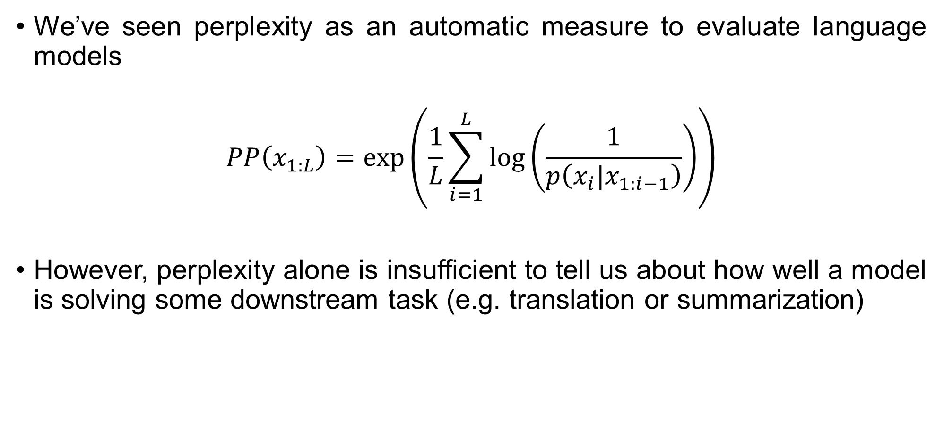
Evaluating Generation
We’ve seen perplexity as an automatic measure to evaluate language models
$$PP\left(x_{1:L}\right)=\text{exp}\left(\frac{1}{L}\sum_{i=1}^{L}{\log\left(\frac{1}{p\left(x_{i}|x_{1:i−1}\right)}\right)}\right)$$
However, perplexity alone is insufficient to tell us about how well a model is solving some downstream task (e.g. translation or summarization)

Slide 4
Evaluating Generation
How good is a model’s generated text?
Imagine you are evaluating an LLM for English-to-French translation.
Input (Source Sentence):
"The cat is on the mat.“
Reference (Ground Truths): These are correct translations written by human experts.
Ref 1: "Le chat est sur le tapis.
Ref 2: "Le chat est posé sur le tapis.
Candidate Output (LLM's Response):
"Le chat est sur la moquette."

Slide 5
Evaluating Generation
How good is a model’s generated text?
Imagine you are evaluating an LLM for English-to-French translation.
Input (Source Sentence):
"The cat is on the mat.“
Reference (Ground Truths): These are correct translations written by human experts.
Ref 1: "Le chat est sur le tapis.
Ref 2: "Le chat est posé sur le tapis.
Candidate Output (LLM's Response):
"Le chat est sur la moquette."
The candidate output is not identical to the references. How do we measure the goodness of the translation?

Slide 6
Evaluating Generation
Confusion Matrix: A confusion matrix is a performance evaluation tool for classification models. It provides a summary of the model’s predictions compared to the actual values.
 | Actually Positive (1) | Actually Negative (0)
Predicted Positive (1) | True Positives | False Positives
Predicted Negative (0) | False Negatives | True Negatives

Slide 7
Evaluating Generation
Confusion Matrix for text-generation
 | Word in the reference | Word not in the reference
Word predicted by model | True Positives Number of words in the candidate that are also in the reference | False Positives Number of words in the candidate that are not present in the reference
Word not predicted by model | False Negatives Number of words in the reference that are not present in the candidate | True Negatives Number of words not predicted by the model that are also not in the reference.

Slide 8
Evaluating Generation
Candidate translation (output of the model):
Israeli officials responsibility of airport safety
Reference Translation (Ground Truth):
Israeli officials are responsible for airport security
True Positives (TP) = 3
False Positives (FP) = 3
False Negatives (TN) = 4

Slide 9
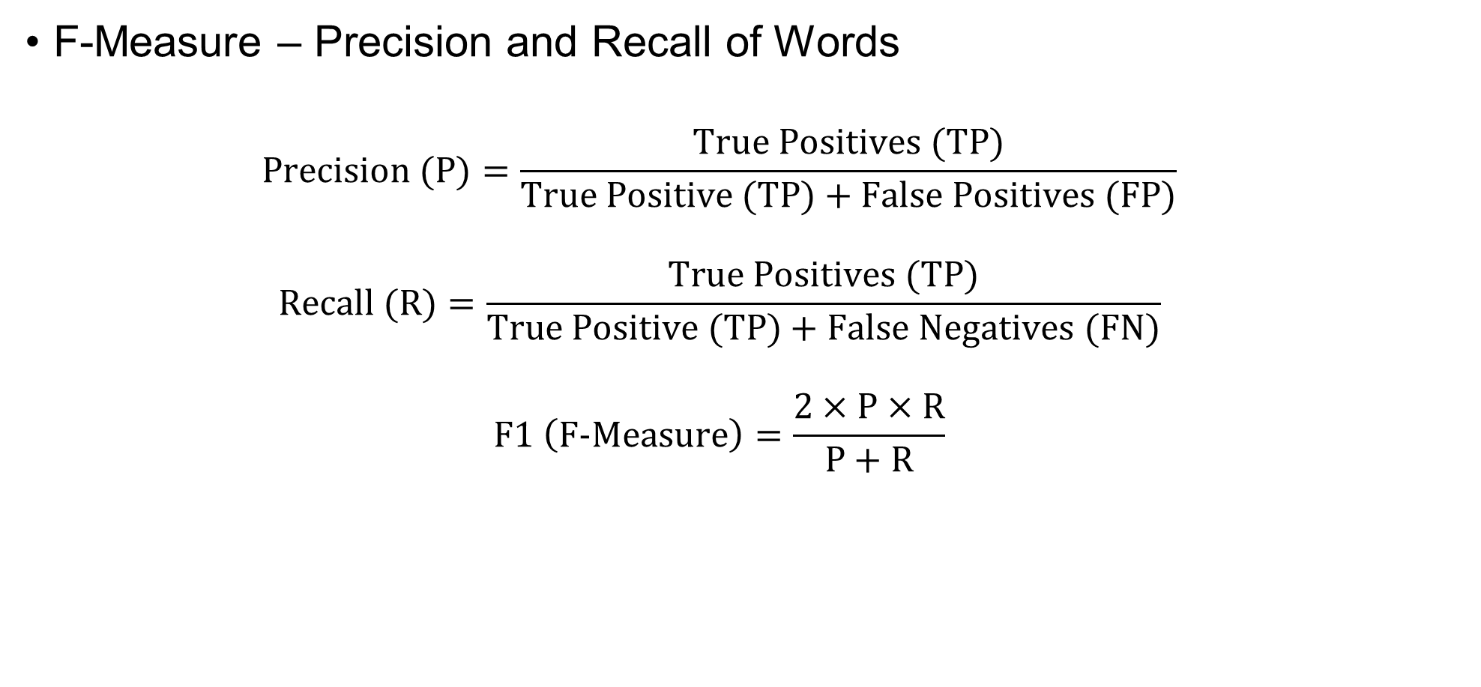
Evaluating Generation
F-Measure – Precision and Recall of Words
$$\text{Precision}\text{ (}\text{P}\text{)}=\frac{\text{True} \text{Positives}\text{ (}\text{TP}\text{)}}{\text{True} \text{Positive}\text{ (}\text{TP}\text{)}+\text{False} \text{Positives}\text{ (}\text{FP}\text{)}}$$
$$\text{Recall}\text{ (}\text{R}\text{)}=\frac{\text{True} \text{Positives}\text{ (}\text{TP}\text{)}}{\text{True} \text{Positive}\text{ (}\text{TP}\text{)}+\text{False} \text{Negatives}\text{ (}\text{FN}\text{)}}$$
$$\text{F}\text{1} \left(\text{F}\text{−}\text{Measure}\right)=\frac{2×\text{P}×\text{R}}{\text{P}+\text{R}}$$

Slide 10
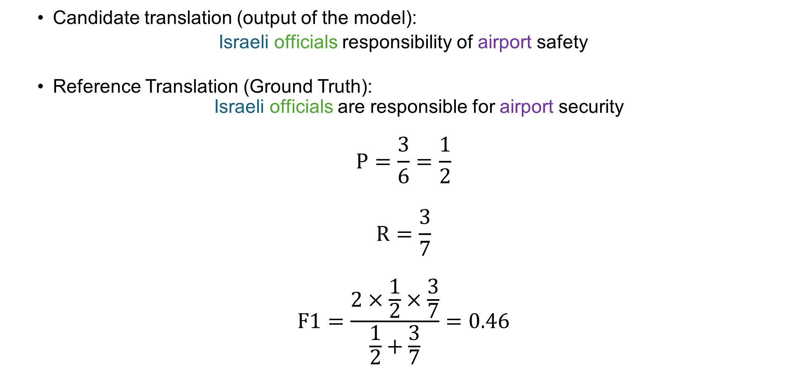
Evaluating Generation
Candidate translation (output of the model):
Israeli officials responsibility of airport safety
Reference Translation (Ground Truth):
Israeli officials are responsible for airport security
$$\text{P}=\frac{3}{6}=\frac{1}{2}$$
$$\text{R}=\frac{3}{7}$$
$$\text{F}\text{1}=\frac{2×\frac{1}{2}×\frac{3}{7}}{\frac{1}{2}+\frac{3}{7}}=0.46$$

Slide 11
Evaluating Generation
System A: Israeli officials responsibility of airport safety
Reference: Israeli officials are responsible for airport security
System B: airport security Israeli officials are responsible
Flaw: no penalty for reordering
Metric | System A | System B
Precision | 50% | 100%
Recall | 43% | 100%
F-Measure | 46% | 100%

Slide 12
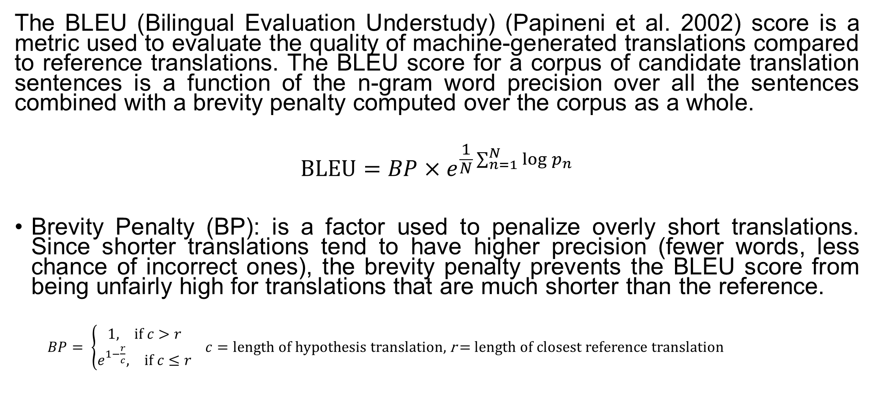
BLEU
The BLEU (Bilingual Evaluation Understudy) (Papineni et al. 2002) score is a metric used to evaluate the quality of machine-generated translations compared to reference translations. The BLEU score for a corpus of candidate translation sentences is a function of the n-gram word precision over all the sentences combined with a brevity penalty computed over the corpus as a whole.
$$\text{BLEU}=BP×e^{\frac{1}{N}\sum_{n=1}^{N}{\log{p_{n}}}}$$
Brevity Penalty (BP): is a factor used to penalize overly short translations. Since shorter translations tend to have higher precision (fewer words, less chance of incorrect ones), the brevity penalty prevents the BLEU score from being unfairly high for translations that are much shorter than the reference.
$BP= \left\{\begin{aligned}1, \text{if} c>r \\ e^{1−\frac{r}{c}}, \text{if} c≤r\end{aligned}\right. c=\text{length} \text{of} \text{hypothesis} \text{translation}\text{, }\text{r}\text{ = }\text{length} \text{of} \text{closest} \text{reference} \text{translation}$

Slide 13

BLEU
$$\text{BLEU}=BP×e^{\frac{1}{N}\sum_{n=1}^{N}{\log{p_{n}}}}$$
$BP= \left\{\begin{aligned}1, \text{if} c>r \\ e^{1−\frac{r}{c}}, \text{if} c≤r\end{aligned}\right. c=\text{length} \text{of} \text{hypothesis} \text{translation}\text{, }\text{r}\text{ = }\text{length} \text{of} \text{closest} \text{reference} \text{translation}$
Precision $p_{n}=\frac{\text{Number} \text{of} \text{n}\text{−}\text{grams} \text{in} \text{system} \text{and} \text{reference} \text{translations}}{\text{Number} \text{of} \text{n}\text{−}\text{grams} \text{in} \text{system} \text{translation} }$
$N$ is usually 4

Slide 14
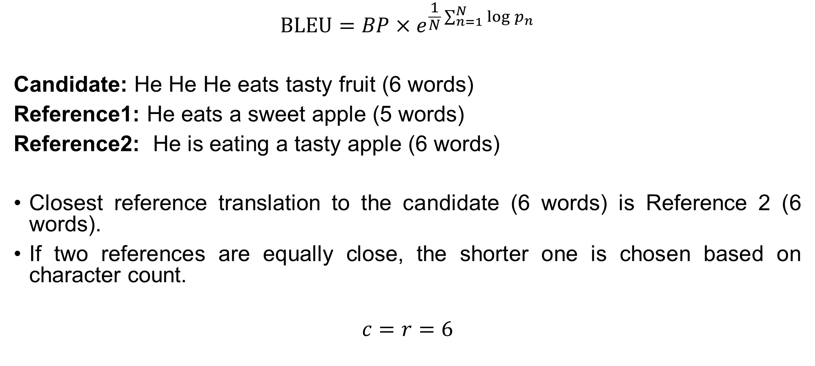
BLEU
$$\text{BLEU}=BP×e^{\frac{1}{N}\sum_{n=1}^{N}{\log{p_{n}}}}$$
Candidate: He He He eats tasty fruit (6 words)
Reference1: He eats a sweet apple (5 words)
Reference2: He is eating a tasty apple (6 words)
Closest reference translation to the candidate (6 words) is Reference 2 (6 words).
If two references are equally close, the shorter one is chosen based on character count.
$$c=r=6$$

Slide 15
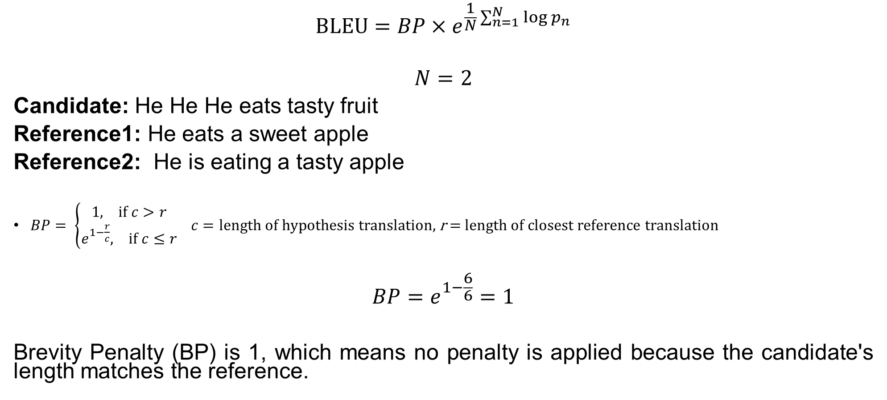
BLEU
$$\text{BLEU}=BP×e^{\frac{1}{N}\sum_{n=1}^{N}{\log{p_{n}}}}$$
$$N=2$$
Candidate: He He He eats tasty fruit
Reference1: He eats a sweet apple
Reference2: He is eating a tasty apple
$BP= \left\{\begin{aligned}1, \text{if} c>r \\ e^{1−\frac{r}{c}}, \text{if} c≤r\end{aligned}\right. c=\text{length} \text{of} \text{hypothesis} \text{translation}\text{, }\text{r}\text{ = }\text{length} \text{of} \text{closest} \text{reference} \text{translation}$
$$BP=e^{1−\frac{6}{6}}=1$$
Brevity Penalty (BP) is 1, which means no penalty is applied because the candidate's length matches the reference.

Slide 16
BLEU
Precision Calculation
Count: The number of occurrences of the n-gram in the candidate
Clipped Count: Limit the count to the maximum count in any reference

Slide 17
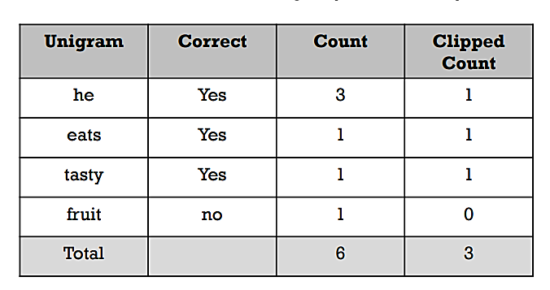
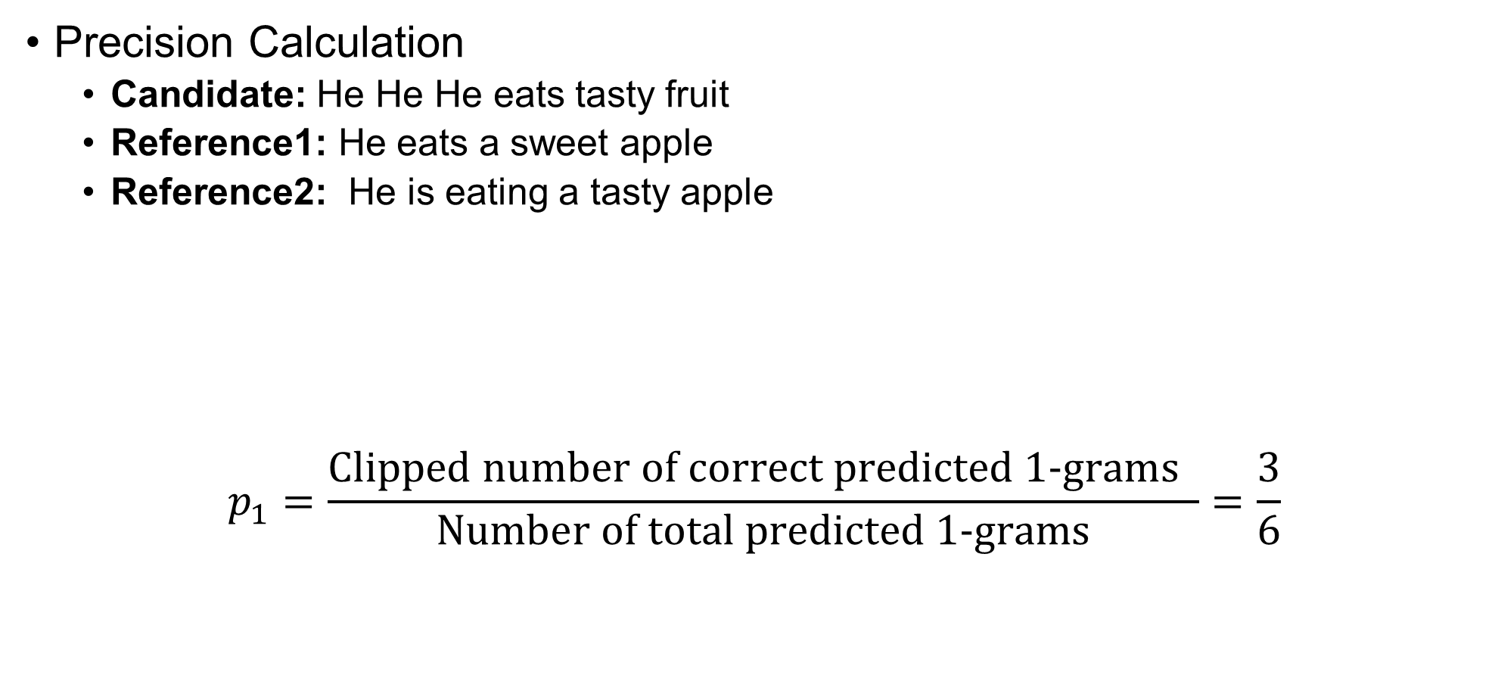
BLEU
Precision Calculation
Candidate: He He He eats tasty fruit
Reference1: He eats a sweet apple
Reference2: He is eating a tasty apple
$$p_{1}=\frac{\text{Clipped} \text{number} \text{of} \text{correct} \text{predicted}\text{ 1−}\text{grams} }{\text{Number} \text{of} \text{total} \text{predicted}\text{ 1−}\text{grams}}=\frac{3}{6}$$

Slide 18
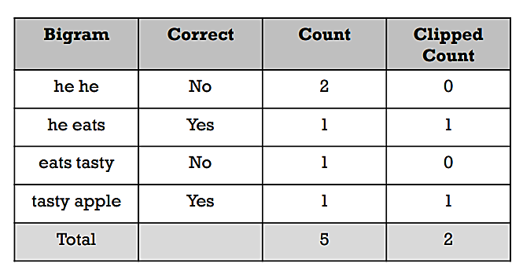
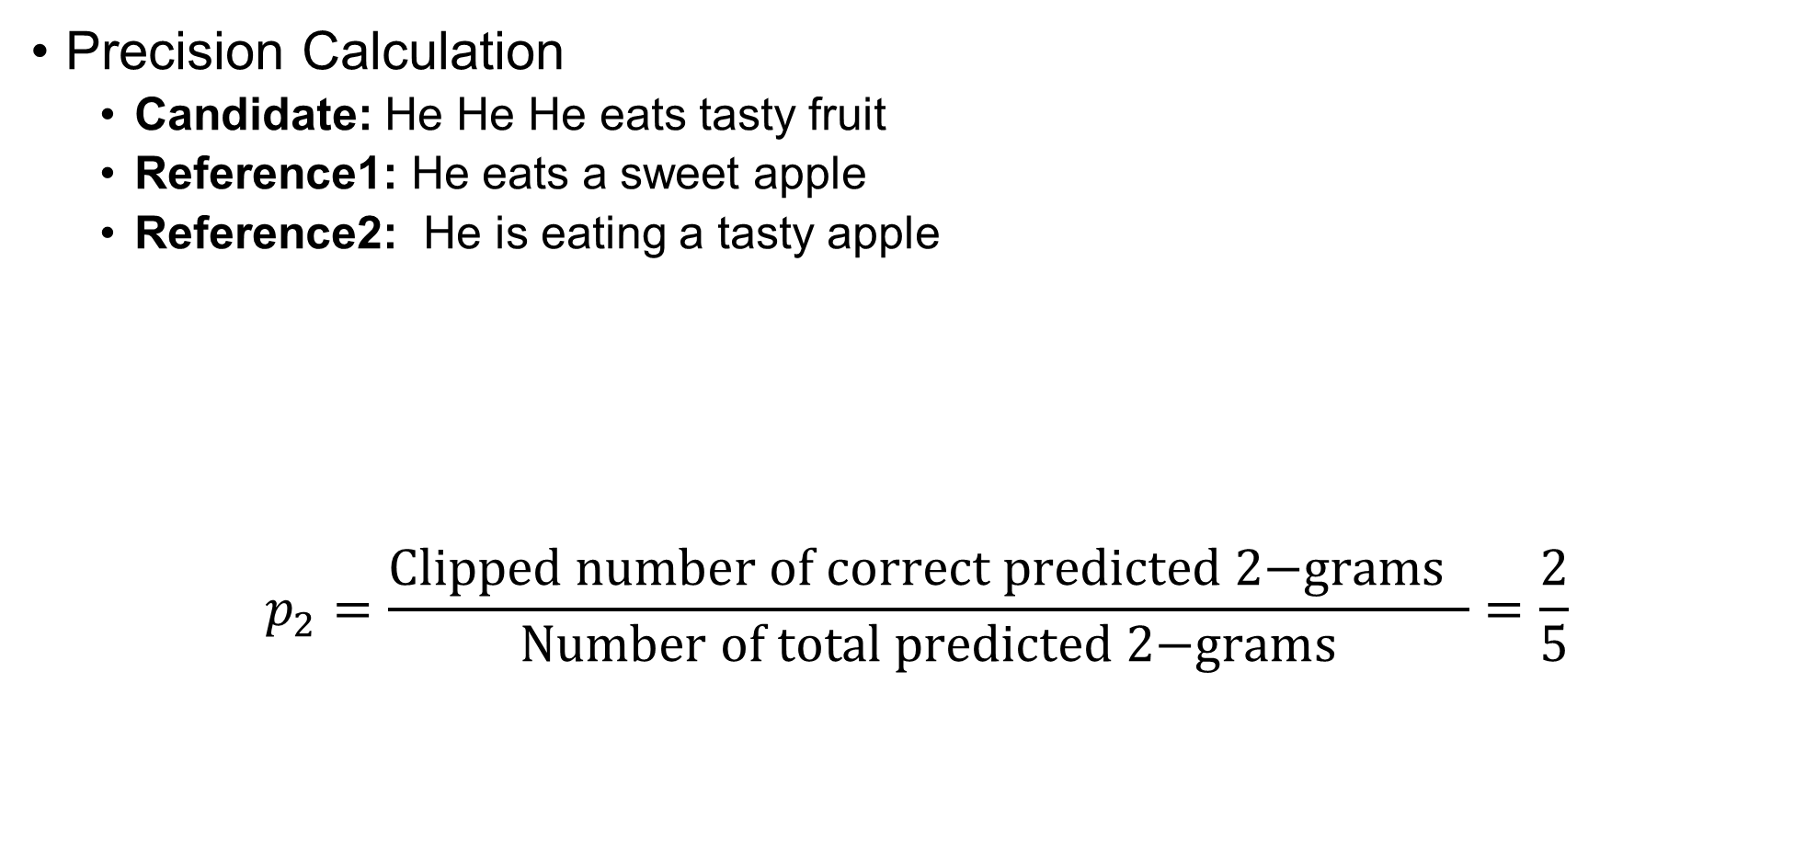
BLEU
Precision Calculation
Candidate: He He He eats tasty fruit
Reference1: He eats a sweet apple
Reference2: He is eating a tasty apple
$$p_{2}=\frac{\text{Clipped} \text{number} \text{of} \text{correct} \text{predicted}\text{ 2−}\text{grams} }{\text{Number} \text{of} \text{total} \text{predicted}\text{ 2−}\text{grams}}=\frac{2}{5}$$

Slide 19
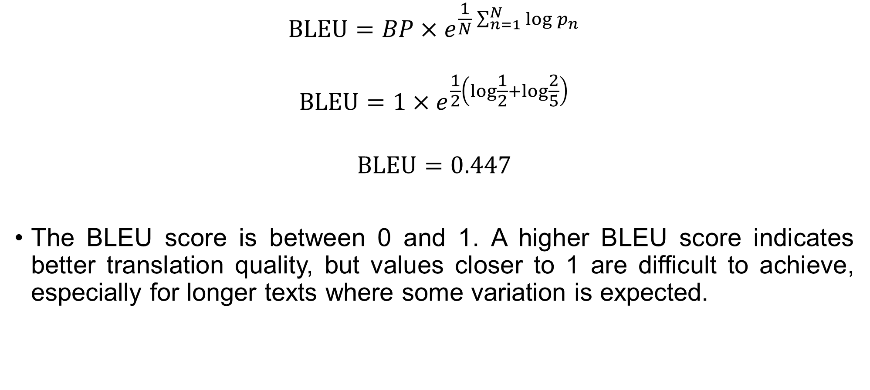
BLEU
$$\text{BLEU}=BP×e^{\frac{1}{N}\sum_{n=1}^{N}{\log{p_{n}}}}$$
$$\text{BLEU}=1×e^{\frac{1}{2}\left(\log{\frac{1}{2}}+\log{\frac{2}{5}}\right)}$$
$$\text{BLEU}=0.447$$
The BLEU score is between 0 and 1. A higher BLEU score indicates better translation quality, but values closer to 1 are difficult to achieve, especially for longer texts where some variation is expected.

Slide 20
ROUGE
ROUGE (Recall-Oriented Understudy for Gisting Evaluation) is a widely used evaluation metric for assessing the quality of text generation tasks, such as summarization and machine translation. Unlike BLEU, which primarily focuses on precision, ROUGE considers both recall and precision, making it well-suited for evaluating how much of the human-written reference text is captured by the model-generated output. It compares candidate against reference using n-grams, skip-bigrams, and longest common subsequences to measure overlap and relevance.

Slide 21
ROUGE
ROUGE is a set of metrics, rather than just one. The main ones that will be discussed are:
ROUGE-N
ROUGE-L
ROUGE-S

Slide 22
ROUGE
ROUGE-N
ROUGE-N evaluates the quality of a model’s output by measuring the overlap of n-grams (sequences of n words) between the model-generated text (candidate) and the human-written reference. The N in ROUGE-N corresponds to the size of the n-gram being compared:
ROUGE-1 measures the overlap of unigrams (single words) between the candidate and reference.
ROUGE-2 focuses on bigrams (pairs of consecutive words).
ROUGE-3 assesses the overlap of trigrams (triplets of consecutive words), and so on.
This metric helps to determine how much of the model's output matches the structure and content of the reference text at different levels of granularity.

Slide 23
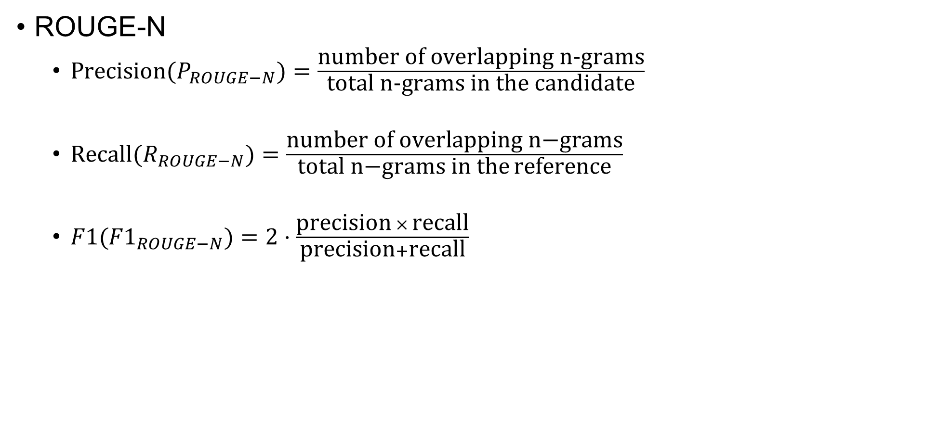
ROUGE
ROUGE-N
$\text{Precision}(P_{ROUGE−N})=\frac{\text{number} \text{of} \text{overlapping} \text{n}\text{-}\text{grams}}{\text{total} \text{n}\text{-}\text{grams} \text{in} \text{the} \text{candidate}}$
$\text{R}\text{ecall}(R_{ROUGE−N})=\frac{\text{number} \text{of} \text{overlapping} \text{n}\text{−}\text{grams}}{\text{total} \text{n}\text{−}\text{grams} \text{in} \text{the} \text{reference}}$
$F1({F1}_{ROUGE−N})=2⋅\frac{\text{precision} × \text{recall}}{\text{precision}+\text{recall}}$

Slide 24
ROUGE
ROUGE-N
Reference: "The cat sat on the mat.“
Candidate: "The cat sat on mat.“
N = 2
Reference bigrams = [('The', 'cat'), ('cat', 'sat'), ('sat', 'on'), ('on', 'the'), ('the', 'mat’)]
Candidate bigrams = [('The', 'cat'), ('cat', 'sat'), ('sat', 'on'), ('on', 'mat’)]
Overlapping bigram count = 3
Total Candidate Bigrams = 4
Total Reference Bigrams = 5

Slide 25

ROUGE
ROUGE-N
$P_{ROUGE−2}=\frac{3}{4}=0.75$
$R_{ROUGE−2}=\frac{3}{5}=0.6$
${F1}_{ROUGE−2}=\frac{2×0.75×0.6}{0.75+0.6}=0.667$

Slide 26
ROUGE
ROUGE-L
ROUGE-L is based on the Longest Common Subsequence (LCS) rather than n-grams. The LCS captures sentence-level structure similarity, making it useful when word order matters but minor modifications are acceptable. LCS is the longest sequence of words appearing in order in both summaries (but not necessarily consecutively).

Slide 27

ROUGE
ROUGE-L
$\text{Precision}(P_{ROUGE−L})=\frac{\text{number} \text{of} \text{tokens} \text{in} \text{LCS} }{\text{total} \text{tokens} \text{in} \text{the} \text{candidate}}$
$\text{R}\text{ecall}(R_{ROUGE−L})=\frac{\text{number} \text{of} \text{tokens} \text{in} \text{LCS} }{\text{total} \text{tokens} \text{in} \text{the} \text{reference}}$
$F1({F1}_{ROUGE−L})=2⋅\frac{\text{precision} × \text{recall}}{\text{precision}+\text{recall}}$

Slide 28
ROUGE
ROUGE-L
Reference: "The cat sat on the mat.“
Candidate: "The cat sat on mat.“
LCS = The cat sat on mat
LCS tokens = 4

Slide 29

ROUGE
ROUGE-L
$P_{ROUGE−L}=\frac{4}{5}=0.8$
$R_{ROUGE−L}=\frac{4}{6}=0.667$
${F1}_{ROUGE−L}=\frac{2×0.8×0.667}{0.8+0.667}=0.727$

Slide 30
ROUGE
ROUGE-S
ROUGE-S stands for ROUGE-Skip-Bigram. Unlike ROUGE-N (which considers only consecutive n-grams), ROUGE-S measures how many skip-bigrams from the reference summary appear in the candidate (generated) summary.
A skip-bigram is any ordered pair of words appearing in the same order in the sentence, even if words are skipped in between.

Slide 31
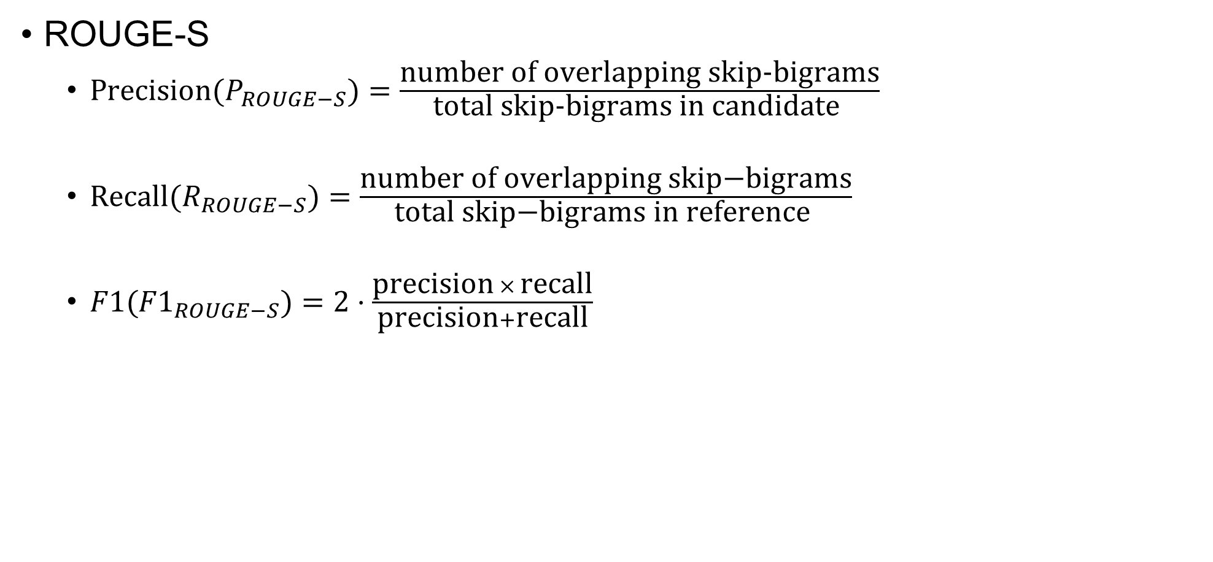
ROUGE
ROUGE-S
$\text{Precision}(P_{ROUGE−S})=\frac{\text{number} \text{of} \text{overlapping} \text{skip}\text{-}\text{bigrams}}{\text{total} \text{skip}\text{-}\text{bigrams} \text{in} \text{candidate} }$
$\text{R}\text{ecall}(R_{ROUGE−S})=\frac{\text{number} \text{of} \text{overlapping} \text{skip}\text{−}\text{bi}\text{grams}}{\text{total} \text{skip}\text{−}\text{bi}\text{grams} \text{in} \text{reference} }$
$F1({F1}_{ROUGE−S})=2⋅\frac{\text{precision} × \text{recall}}{\text{precision}+\text{recall}}$

Slide 32
ROUGE
ROUGE-S
Reference: "The cat sat on the mat.“
Candidate: "The cat sat on mat.“
Reference skip-bigrams = [
('The', 'cat'), ('The', 'sat'), ('The', 'on'), ('The', 'the'), ('The', 'mat’),
('cat', 'sat'), ('cat', 'on'), ('cat', 'the'), ('cat', 'mat’),
('sat', 'on'), ('sat', 'the'), ('sat', 'mat’),
('on', 'the'), ('on', 'mat’),
('the', 'mat’)
]
Candidate skip-bigrams = [
('The', 'cat'), ('The', 'sat'), ('The', 'on'), ('The', 'mat’),
('cat', 'sat'), ('cat', 'on'), ('cat', 'mat’),
('sat', 'on'), ('sat', 'mat’),
('on', 'mat')
]
Overlapping skip-bigrams = 10, Reference skip-bigrams = 15, Candidate skip-bigrams = 10

Slide 33

ROUGE
ROUGE-S
$P_{ROUGE−S}=\frac{\text{10}}{\text{10}}=1$
$R_{ROUGE−S}=\frac{\text{10}}{\text{15}}=0.667$
${F1}_{ROUGE−S}=2⋅\frac{\text{1} × \text{0.667}}{\text{1+0.667}}=0.800$

Slide 34
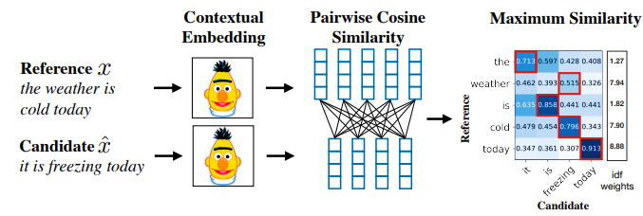
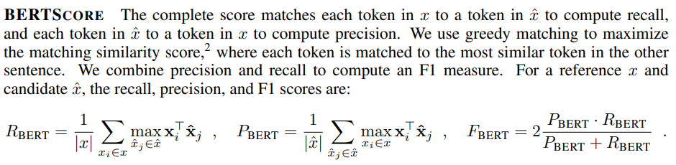
BERT Score
Measures the similarity between model predictions and a set of ground truths by computing cosine similarities between word embeddings of the reference and candidate sentences generated using BERT.
Assigns a score between 0 and 1 for each reference (ground truth) and candidate (prediction) pair

Slide 35
BERT Score
Reference Sentence
“dog runs”
Candidate Sentence
“puppy moves”
We create word embeddings using BERT for the both the reference sentence and the candidate sentence. For simplicity, we use 3-dimensional embeddings (as we have seen before, actual BERT embeddings are much larger)

Slide 36
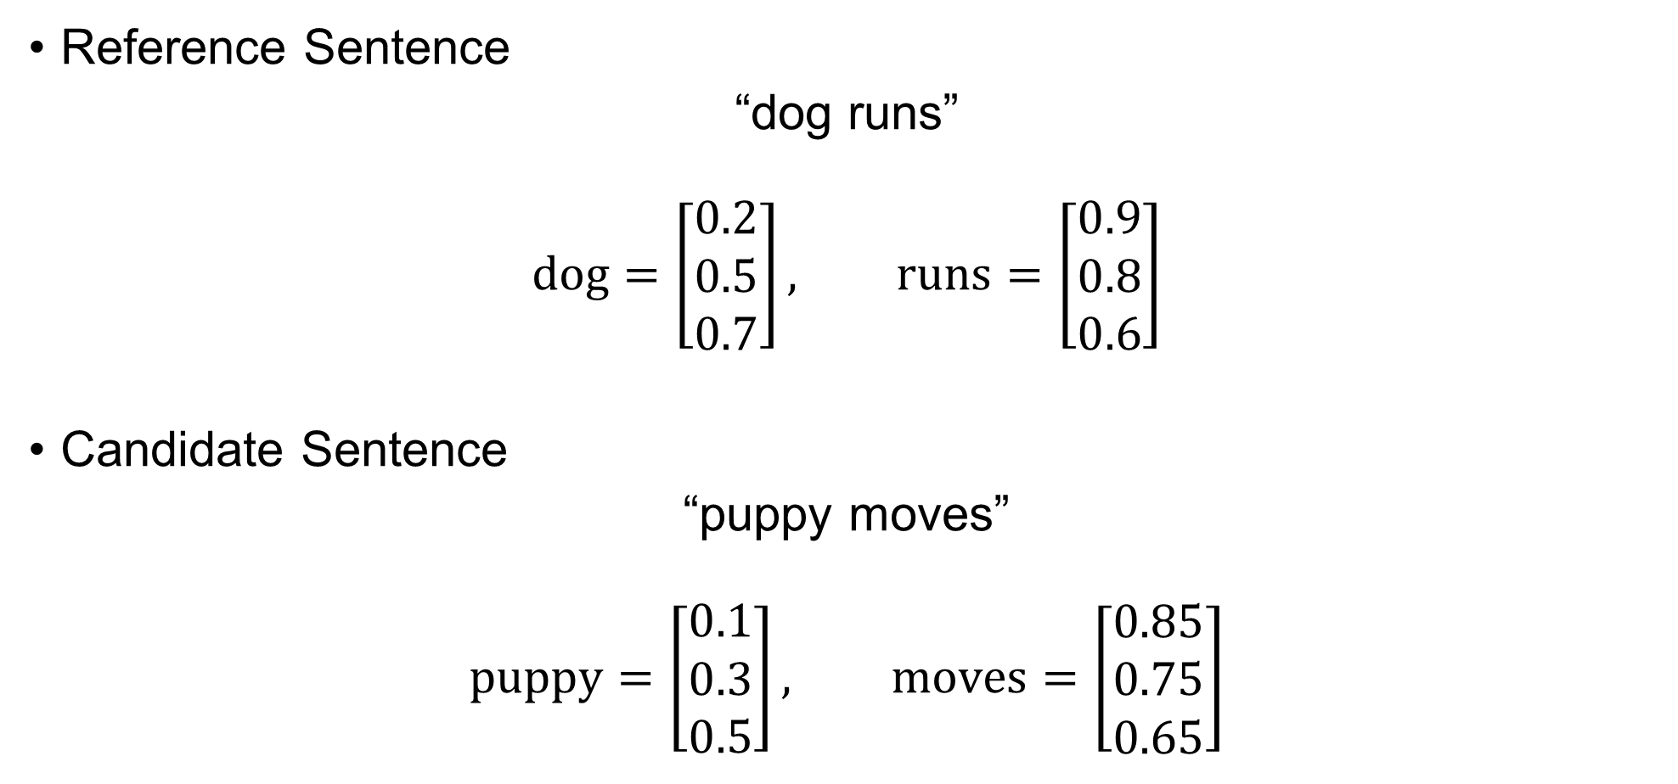
BERT Score
Reference Sentence
“dog runs”
$$\text{d}\text{og}=\left[\begin{matrix}0.2 \\ 0.5 \\ 0.7\end{matrix}\right], \text{runs}=\left[\begin{matrix}0.9 \\ 0.8 \\ 0.6\end{matrix}\right]$$
Candidate Sentence
“puppy moves”
$$\text{p}\text{uppy}=\left[\begin{matrix}0.1 \\ 0.3 \\ 0.5\end{matrix}\right], \text{moves}=\left[\begin{matrix}0.85 \\ 0.75 \\ 0.65\end{matrix}\right]$$

Slide 37
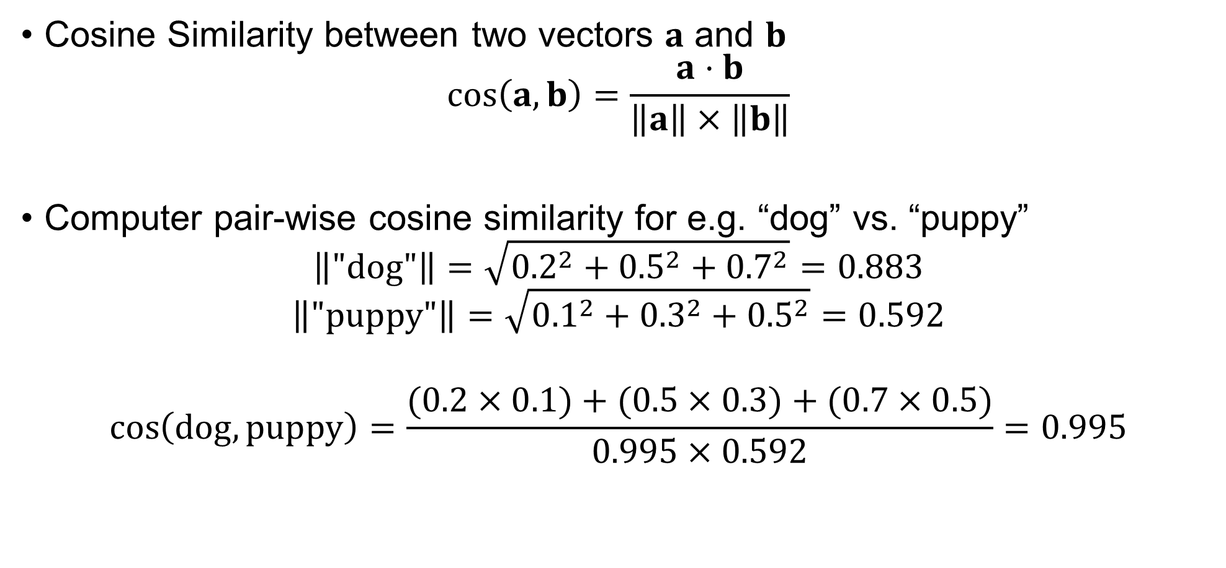
BERT Score
Cosine Similarity between two vectors $a$ and $b$
$$\cos\left(a,b\right)=\frac{a⋅b}{\left\|a\right\|×\left\|b\right\|}$$
Computer pair-wise cosine similarity for e.g. “dog” vs. “puppy”
$$\left\|\text{"}\text{dog}\text{"}\right\|=\sqrt{{0.2}^{2}+{0.5}^{2}+{0.7}^{2}}=0.883$$
$$\left\|\text{"}\text{puppy}\text{"}\right\|=\sqrt{{0.1}^{2}+{0.3}^{2}+{0.5}^{2}}=0.592$$
$$\cos\left(\text{dog},\text{puppy}\right)=\frac{(0.2×0.1)+(0.5×0.3)+(0.7×0.5)}{0.995×0.592}=0.995$$

Slide 38
BERT Score
Pair-wise cosine similarities
Cosine similarity between “dog" and “puppy" = 0.995
Cosine similarity between “dog" and “moves" = 0.867
Cosine similarity between “runs" and “puppy" = 0.792
Cosine similarity between “runs" and “moves" = 0.998

Slide 39

BERT Score
Precision
Candidate vs. Reference
$$puppy: max\left(0.995,0.792\right)=0.995$$
$$\text{moves}:\max\left(0.867,0.998\right)=0.998$$
$$P_{BERT}=\frac{1}{2}\left(\max\left(0.995, 0.792\right)+\max\left(0.867,0.998\right)\right)$$
$$P_{BERT}=\frac{1}{2}\left(0.995+0.998\right)=0.9965$$

Slide 40

BERT Score
Recall
Reference vs. Candidate
$$\text{dog}: \max\left(0.995,0.867\right)=0.995$$
$$\text{r}\text{uns}:\max\left(0.792,0.998\right)=0.998$$
$$R_{BERT}=\frac{1}{2}\left(\max\left(0.995, 0.867\right)+\max\left(0.792,0.998\right)\right)$$
$$R_{BERT}=\frac{1}{2}\left(0.995+0.998\right)=0.9965$$

Slide 41
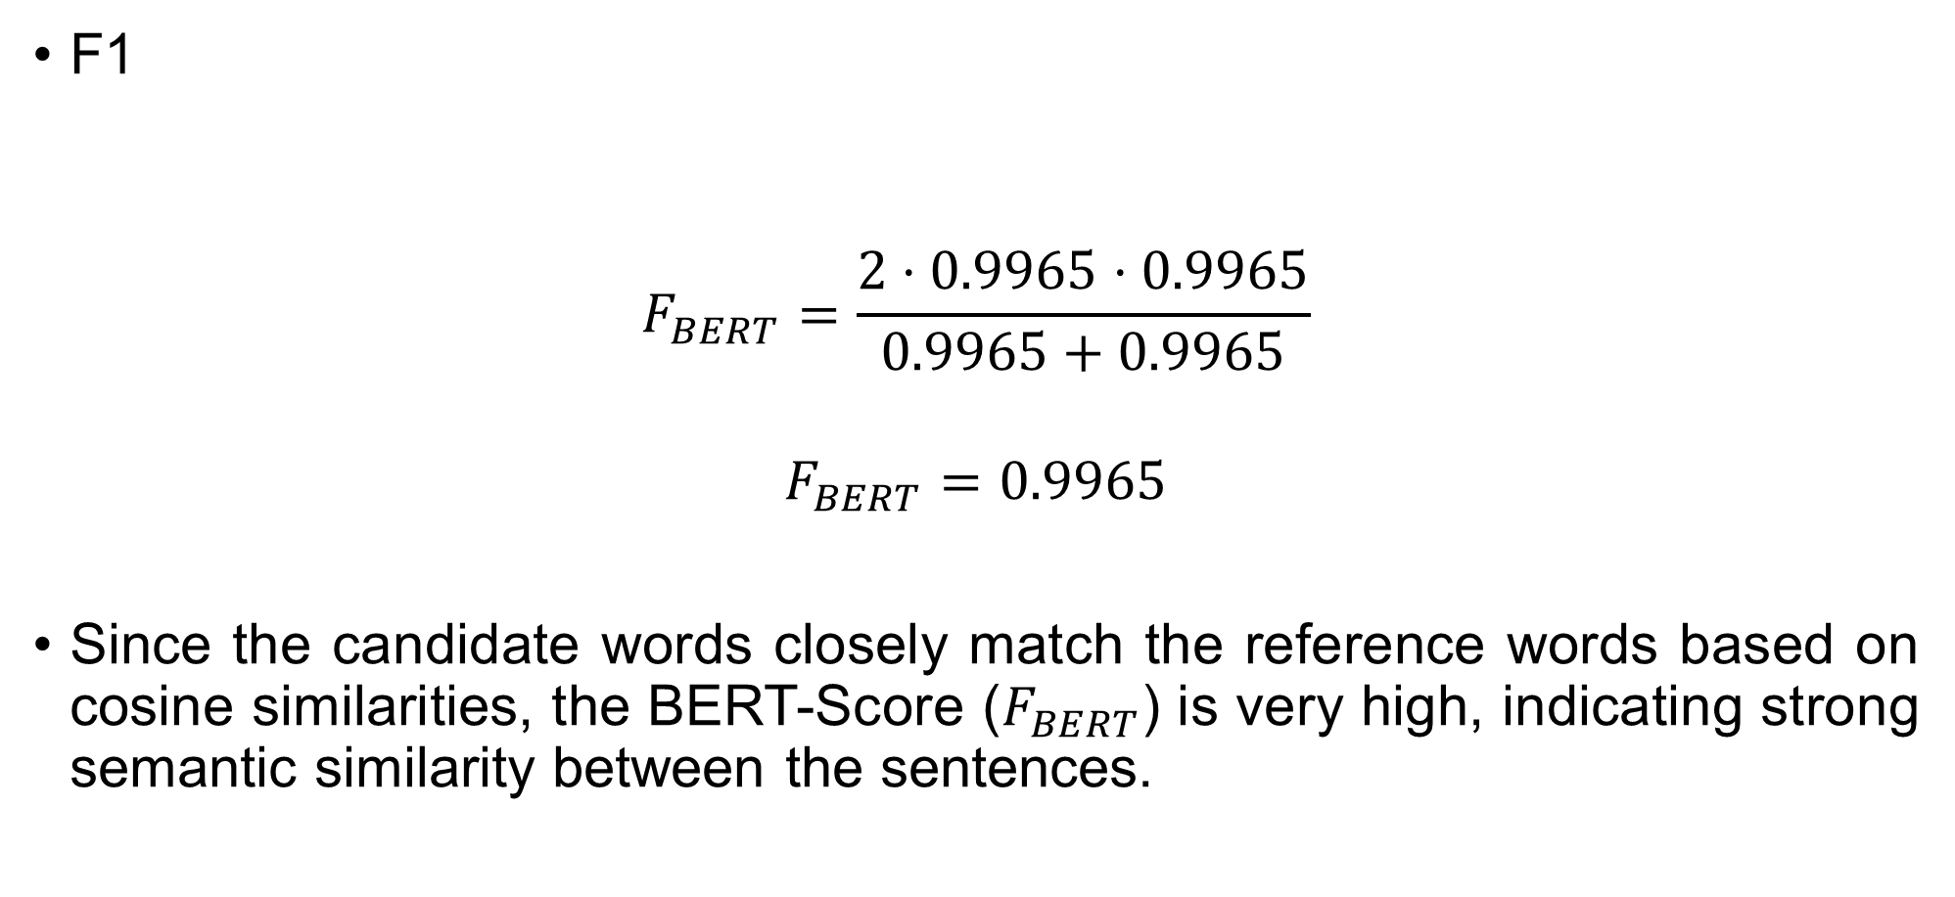
BERT Score
F1
$$F_{BERT}=\frac{2⋅0.9965⋅0.9965}{0.9965+0.9965}$$
$$F_{BERT}=0.9965$$
Since the candidate words closely match the reference words based on cosine similarities, the BERT-Score ($F_{BERT}$) is very high, indicating strong semantic similarity between the sentences.

Slide 42
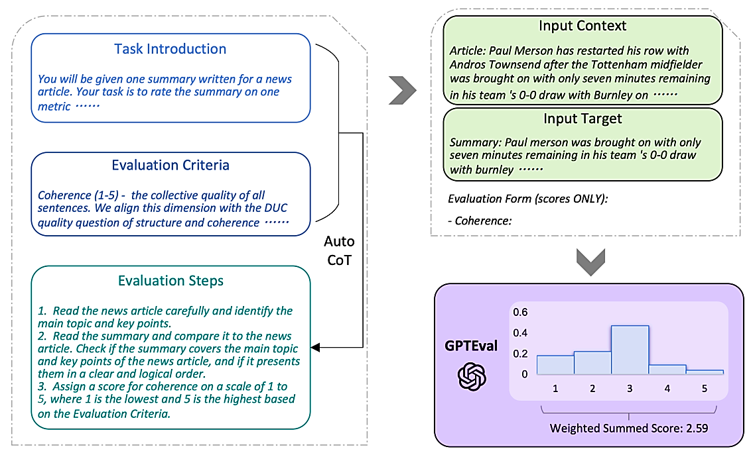
Evaluating Generation – Machine Translation
LLMs as Judges: Use a powerful LLM like GPT4 to assign a score to generated text based on some evaluation criteria. (GPTEval, Liu et al., 2023)

Slide 43
References
Papineni, K., Roukos, S., Ward, T., & Zhu, W.-J. (2002). BLEU: A method for automatic evaluation of machine translation.
Lin, C.-Y. (2004). ROUGE: A package for automatic evaluation of summaries. Text Summarization Branches
Devlin, J., Chang, M.-W., Lee, K., & Toutanova, K. (2019). BERT: Pre-training of deep bidirectional transformers for language understanding.
Liu, Y., Zhang, Y., Wei, J., et al. (2023). GPTEval: Leveraging GPT models for automatic evaluation of free-form text.

